Slide 1
ERROR DETECTING CODE USING CYCLIC REDUNDANCY CHECK (CRC-CCITT 16-bit)
CCITT- CONSULTATIVE COMMITTEE FOR INTERNATIONAL TELEGRAPHY AND TELEPHONY
Notes:
<number>

Slide 2
OBJECTIVE
<number>
To implement error detection using Cyclic Redundancy Check (CRC- CCITT 16-bit) technique.
Notes:
<number>

Slide 3
DATA TRANSMISSION
<number>
Data transmission refers to the movement of data in the form of bits between two or more digital devices.
This transfer of data takes place via some form of transmission media (for example, coaxial cable, fibre optics etc.)

Slide 4
TYPES OF DATA TRANSMISSION
<number>

Slide 5
PARALLEL DATA TRANSMISSION
<number>
In parallel transmission, all the data bits are transmitted simultaneously on separate communication lines.
In order to transmit ‘n’ bits of data, ‘n’ wires or lines are used.
Parallel transmission is used for short distance communication.

Slide 6
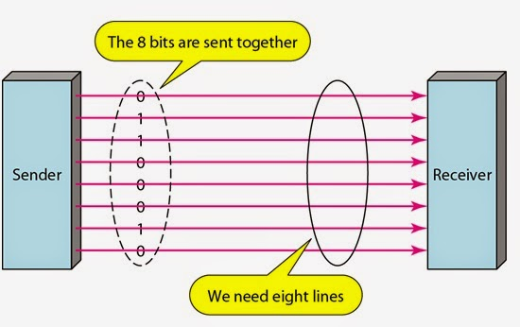
PARALLEL DATA TRANSMISSION BLOCK DIAGRAM
<number>

Slide 7
ADVANTAGE / DISADVANTAGE OF PARALLEL TRANSMISSION
<number>
Advantage:
It is fastest method of transmitting data as multiple data bits are transmitted simultaneously with a single clock pulse.
Disadvantage:
It is costly method of data transmission as it requires ‘n’ lines to transmit ‘n’ bits at the same time.

Slide 8
SERIAL DATA TRANSMISSION
<number>
In serial transmission, the data bits transmitted serially one after the other.
It requires only one communication line to transmit data from sender to receiver.
Serial transmission is used for long distance communication.

Slide 9
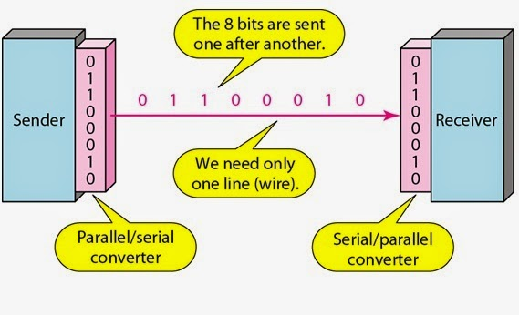
SERIAL DATA TRANSMISSION: BLOCK DIAGRAM
<number>

Slide 10
ADVANTAGE/ DISADVANTAGE OF SERIAL TRANSMISSION
<number>
Advantage:
Use of single communication line reduces the transmission line cost by the factor of ‘n’ as compared to parallel transmission.
Disadvantages:
Use of conversion devices at source and destination end may lead to increase in overall transmission cost.
This method is slower as compared to parallel transmission as bits are transmitted serially one after the other.

Slide 11
TYPES OF SERIAL TRANSMISSION
<number>
There are two types of serial transmission
Synchronous
Asynchronous
Both of these transmissions use 'Bit synchronization'
Bit Synchronization is a function that is required to determine when the beginning and end of the data transmission occurs.
Bit synchronization helps the receiving computer to know when data begin and end during a transmission.
Therefore bit synchronization provides timing control.

Slide 12
ASYNCHRONOUS TRANSMISSION
<number>
Asynchronous transmission sends only one character at a time where a character is either a letter of the alphabet or number or control character i.e. it sends one byte of data at a time.
Bit synchronization between two devices is made possible using start bit and stop bit.
Start bit indicates the beginning of data i.e. alerts the receiver to the arrival of new group of bits. A start bit usually 0 is added to the beginning of each byte.
Stop bit indicates the end of data i.e. to let the receiver know that byte is finished, one or more additional bits are appended to the end of the byte. These bits, usually 1s are called stop bits.

Slide 13
ASYNCHRONOUS TRANSMISSION: PICTORIAL REPRESENTATION
<number>
Stop bit | Data bits | Start bit
1 | 1 1 0 1 0 1 0 0 | 0

Slide 14
APPLICATIONS/ ADVANTAGES OF ASYNCHRONOUS TRANSMISSION
<number>
Asynchronous transmission is well suited for keyboard type-terminals and paper tape devices.
The advantage of this method is that it does not require any local storage at the terminal or the computer as transmission takes place character by character.
Asynchronous transmission is best suited to Internet traffic in which information is transmitted in short bursts.
This type of transmission is used by modems.

Slide 15
DISADVANTAGES OF ASYNCHRONOUS DATA TRANSMISSION
<number>
This method is less efficient and slower than synchronous transmission due to the overhead of extra bits and insertion of gaps into bit stream.
Successful transmission inevitably depends on the recognition of the start bits. These bits can be missed or corrupted.

Slide 16
SYNCHRONOUS TRANSMISSION
<number>
In this method bit stream is combined into longer frames that may contain multiple bytes.
There is no gap between the various bytes in the data stream.
In the absence of start & stop bits, bit synchronization is established between sender & receiver by 'timing' the transmission of each bit.
Since the various bytes are placed on the link without any gap, it is the responsibility of receiver to separate the bit stream into bytes so as to reconstruct the original information.
In order to receive the data error free, the receiver and sender operates at the same clock frequency.
Synchronous transmission is used for high speed communication between computers.

Slide 17
SYNCHRONOUS TRANSMISSION: BLOCK DIAGRAM
<number>
Sender
Receiver
10101010110011110101111000110011110110011
Direction of Data Flow

Slide 18
ADVANTAGE OF SYNCHRONOUS TRANSMISSION
<number>
Advantage:
This method is faster as compared to asynchronous as there are no extra bits (start bit & stop bit) and also there is no gap between the individual data bytes.
Disadvantages:
It is costly as compared to asynchronous method. It requires local buffer storage at the two ends of line to assemble blocks
It also requires accurately synchronized clocks at both ends. This lead to increase in the cost.

Slide 19
ERROR
<number>
Networks must be able to transfer data from one device to another with acceptable accuracy.
For most applications, a system must guarantee that the data received are identical to the data transmitted.
Data can be corrupted during transmission.
Some applications require that errors be detected and corrected.
Small level of errors are acceptable in applications like audio or video transmissions.
High level of accuracy is expected in text transmission.

Slide 20
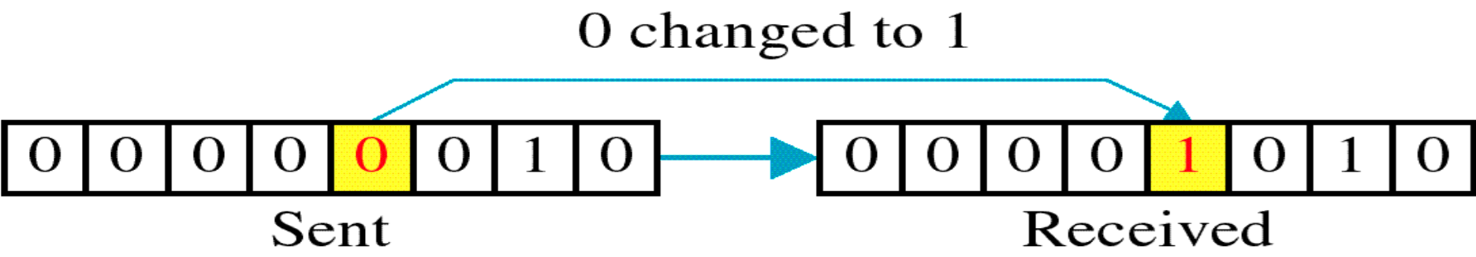
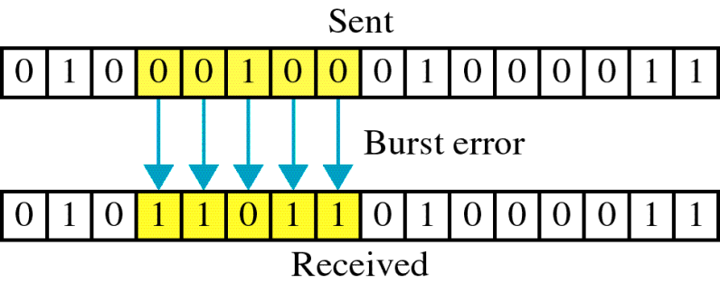
Types of Errors
<number>
Single bit error: only one bit in the data unit has changed.
Burst error: two or more bits in the data unit have changed.

Slide 21
ERROR DETECTING CODES
<number>
Whenever a message is transmitted, it may get scrambled by noise or data may get corrupted.
Basic approach used for error detection is the use of redundancy bits, where additional bits are added to facilitate detection of errors.

Slide 22
POPULAR TECHNIQUES FOR ERROR DETECTION
<number>
Simple Parity check
Two-dimensional Parity check
Checksum
Cyclic redundancy check

Slide 23
SIMPLE PARITY CHECK
<number>
Blocks of data from the source are subjected to a check bit or parity bit generator form, where a parity of :
1 is added to the block if it contains odd number of 1’s, and
0 is added if it contains even number of 1’s
This scheme makes the total number of 1’s even, that is why it is called even parity checking.

Slide 24
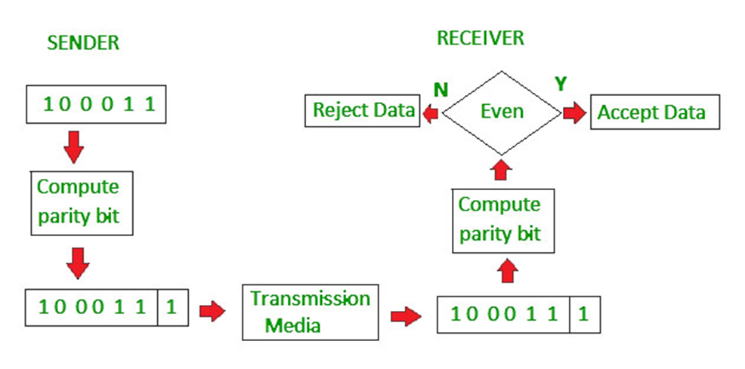
SIMPLE PARITY CHECK: EXAMPLE
<number>

Slide 25
TWO-DIMENSIONAL PARITY CHECK
<number>
Parity check bits are calculated for each row, which is equivalent to a simple parity check bit.
Parity check bits are also calculated for all columns, then both are sent along with the data.
At the receiving end these are compared with the parity bits calculated on the received data.

Slide 26
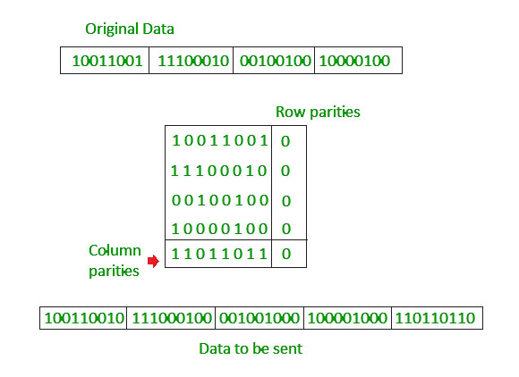
TWO-DIMENSIONAL PARITY CHECK: EXAMPLE
<number>

Slide 27
CHECKSUM
<number>
In checksum error detection scheme, the data is divided into ‘k’ segments each of ‘m’ bits.
In the sender’s end the segments are added using 1’s complement arithmetic to get the sum. The sum is complemented to get the checksum.
The checksum segment is sent along with the data segments.
At the receiver’s end, all received segments are added using 1’s complement arithmetic to get the sum. The sum is complemented.
If the result is zero, the received data is accepted; otherwise discarded.

Slide 28
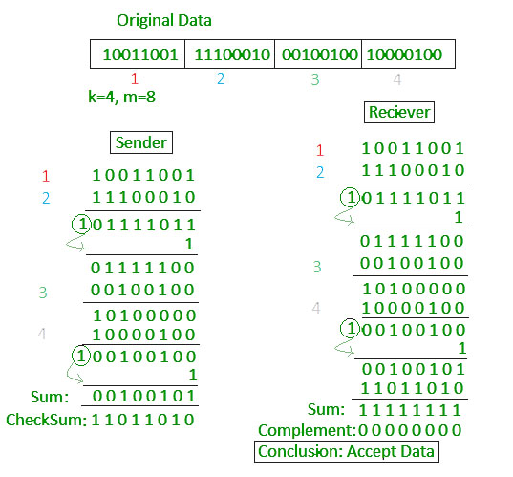
CHECKSUM: EXAMPLE
<number>

Slide 29
CYCLIC REDUNDANCY CHECK (CRC)
<number>
Unlike checksum scheme, which is based on addition, CRC is based on binary division.
In CRC, a sequence of redundant bits, called cyclic redundancy check bits, are appended to the end of data unit so that the resulting data unit becomes exactly divisible by a second, predetermined binary number.
At the destination, the incoming data unit is divided by the same number. If at this step there is no remainder, the data unit is assumed to be correct and is therefore accepted.
A remainder indicates that the data unit has been damaged in transit and therefore must be rejected.

Slide 30
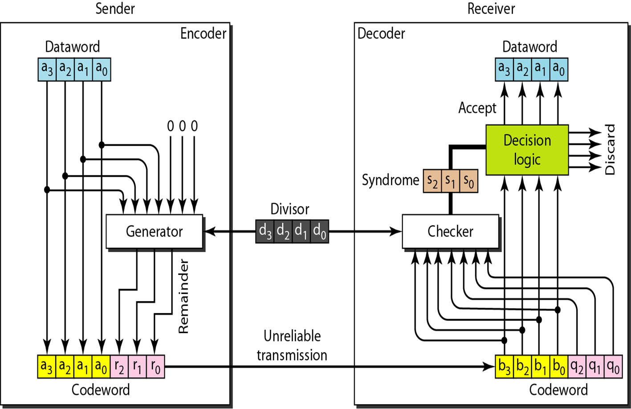
CRC ENCODER AND DECODER
<number>

Slide 31
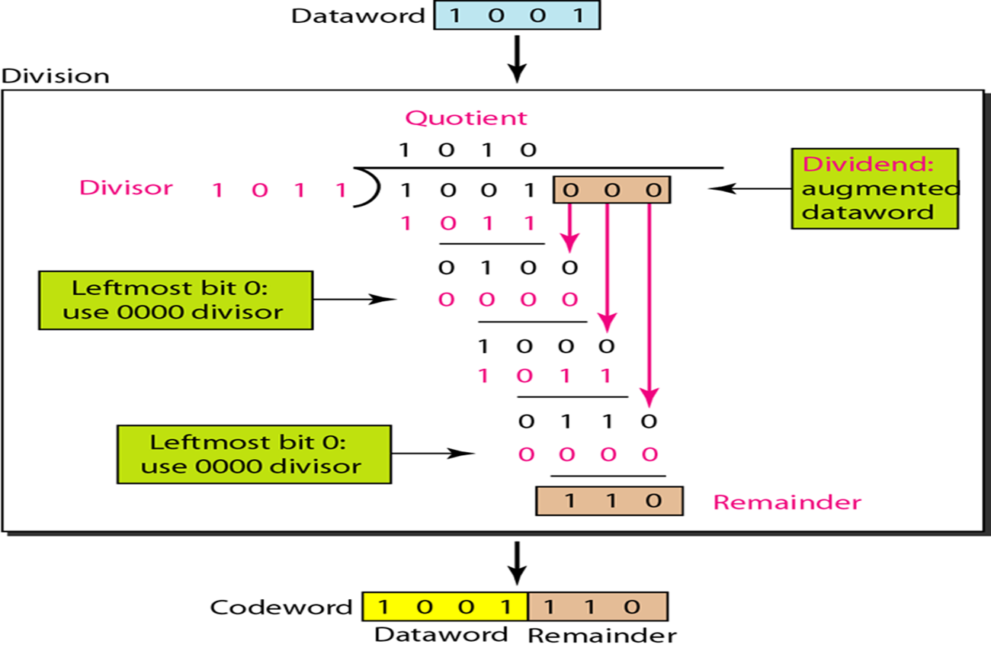
DIVISION IN CRC ENCODER
<number>

Slide 32
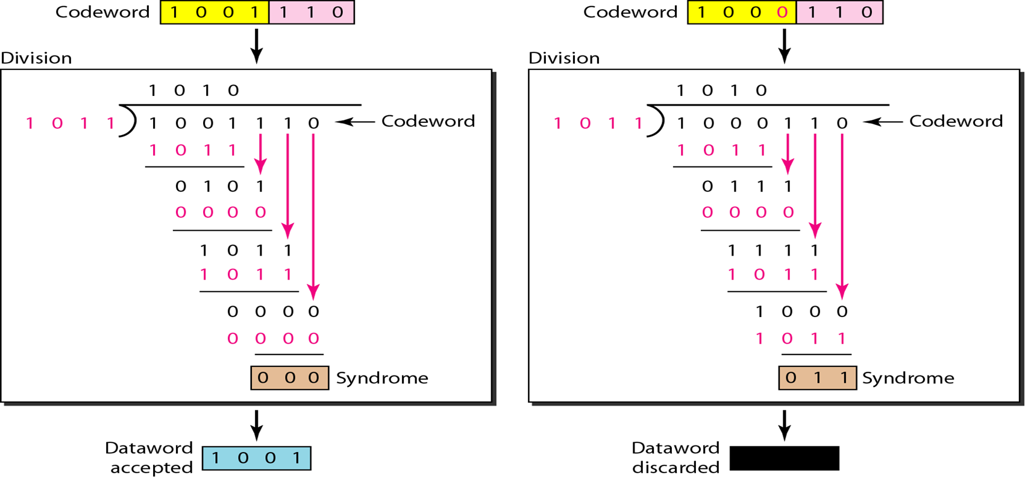
DIVISION IN CRC DECODER
<number>

Slide 33
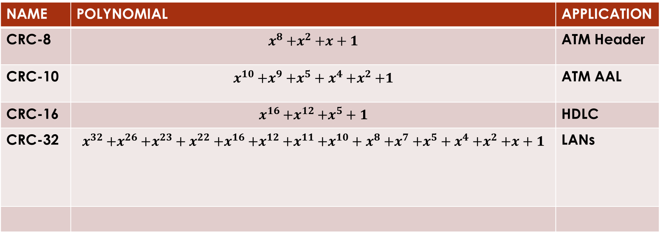
STANDARD POLYNOMIALS
<number>
NAME | POLYNOMIAL | APPLICATION
CRC-8 |  | ATM Header
CRC-10 |  | ATM AAL
CRC-16 |  | HDLC
CRC-32 |  | LANs
NAME | POLYNOMIAL | APPLICATION
CRC-8 |  | ATM Header
CRC-10 |  | ATM AAL
CRC-16 |  | HDLC
CRC-32 |  | LANs

Slide 34
ADVANTAGES OF CYLIC CODES
<number>
Cyclic codes have a very good performance in detecting single-bit errors, double bit errors, an odd number of errors.
They can easily be implemented in hardware and software.
They are especially fast when implemented in hardware.

Slide 35
ALGORITHM
<number>
The message bits to be transmitted are appended with ‘c’ (highest degree of generator polynomial-1) zero bits; this augmented message is the dividend.
A predetermined c+1-bit binary sequence, called the generator polynomial, is the divisor.
The checksum is the c-bit remainder that results from the division operation.
Consider a message represented by the polynomial M(x).
Consider a generating polynomial G(x).
This is used to generate a CRC = C(x) to be appended to M(x). Note this G(x) is prime.
Multiply M(x) by highest power in G(x). i.e. Add So much zeros to M(x).
Divide the result by G(x). The remainder = C(x).
Transmit: T(x) = M(x) + C(x)
Receiver end: Receive T(x). Divide by G(x), should have remainder 0.

Slide 36
<number>
SOURCE CODE
#include<stdio.h>
int message[100];
int b[100];
int j;
int length;
// Generator Polynomial: g(x) = x^16 + x^12 + x^5 + 1
// here x^16 , means x to the power of 16,
// to remember degree of x, array gp is used
// x to the power of 16 15 14 13 12 11 10 9 8 7 6 5 4 3 2 1 0
int gp[17]={ 1, 0, 0, 0, 1, 0, 0, 0, 0, 0, 0, 1, 0, 0, 0, 0, 1};
void divide( int k )
{
int i;
int j;
int count=0;

Slide 37
for( i=0; i<k; i++ )
{
if( message[i] == gp[0] )
{
for( j=i; j<17+i; j++ )
{
message[j] = message[j] ^ gp[count++];
}
}
count=0;
}
}
int main()
{
int i; // index, to iterate through message
printf("\n Enter the length of Data Frame : ");
scanf("%d",&length);
printf("\n Enter the Message (in bits, i.e. 0's and 1's)");
printf("\n But each bit separated by space or a new line: ");
<number>

Slide 38
for( i=0; i < length; i++ )
{
scanf("%d",&message[i]);
}
for( i=0; i < 16; i++ ) // Append r(16) degree zeros to message bits
{
message[length++] = 0;
} // Now it is content of message followed by 16 0's
for( i=0; i < length; i++ ) // Xr.M(x) (ie. Msg+16 Zeros)
{
b[i] = message[i];
}
divide( length - 16 ); //No of times to be divided i.e. message length
for( i=0; i < length; i++ )
{
b[i] = b[i] ^ message[i]; //MOD 2 Substraction
}
<number>

Slide 39
printf("\n Data to be transmitted : ");
for( i=0; i < length; i++ )
{
printf("%2d", b[i]);
}
printf("\n\n Enter the Received Data : ");
for( i=0; i < length; i++ )
{
scanf("%d", &message[i] );
}
divide( length - 16 ); //No of times to be divided i.e. message length
<number>

Slide 40
for( i=0; i < length; i++ )
{
if( message[i] != 0 )
{
printf("\n ERROR in Received Data\n");
return 0;
}
}
printf("\n Data Received is ERROR FREE\n");
return 0;
}
<number>

Slide 41
EXPECTED OUTPUT
CASE:1
<number>
Enter the length of Data Frame : 8
Enter the Message (in bits, i.e. 0's and 1's)
But each bit separated by space or a new line: 1 1 0 0 1 0 1 0
Data to be transmitted : 1 1 0 0 1 0 1 0 0 1 1 1 1 0 0 0 0 0 0 0 0 1 1 0
On receiver end, enter the Received Data : 1 1 0 0 1 0 1 0 0 1 1 1 1 0 0 0 0 0 0 0 0 1 1 0
Data Received is ERROR FREE

Slide 42
EXPECTED OUTPUT
CASE:2
<number>
Enter the length of Data Frame : 8
Enter the Message (in bits, i.e. 0's and 1's)
And each bit separated by space or a new line: 1 1 0 0 1 0 1 0 0 1 1 1 1 0 0 0 0 0 0 0 0 1 1 0
Data to be transmitted : 1 1 0 0 1 0 1 0 0 1 1 1 1 0 0 0 0 0 0 0 0 1 1 0
On receiver end, enter the Received Data : 0 1 0 0 1 0 1 0 0 1 1 1 1 0 0 0 0 0 0 0 0 1 1 0
ERROR in Received Data

Slide 43
EXPECTED OUTCOME
Students will be able to implement error detection code using CRC-CCITT 16 bit technique.

Slide 44
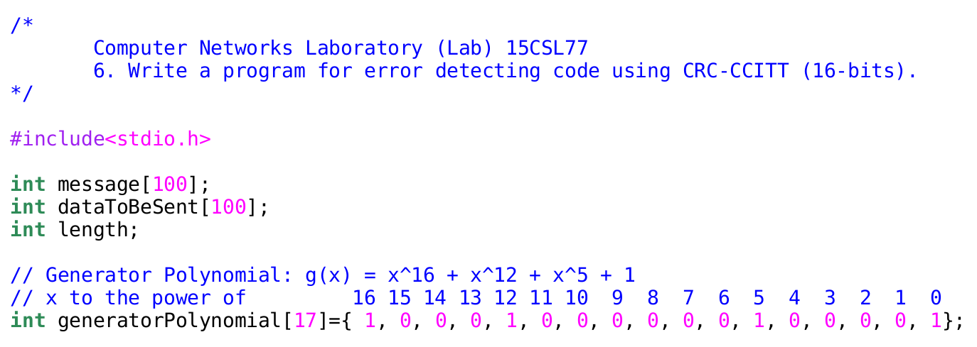

Slide 45
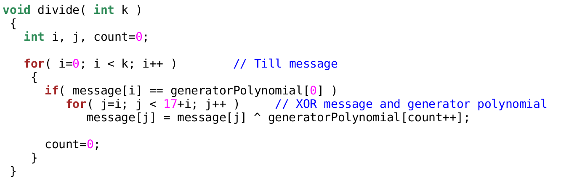

Slide 46
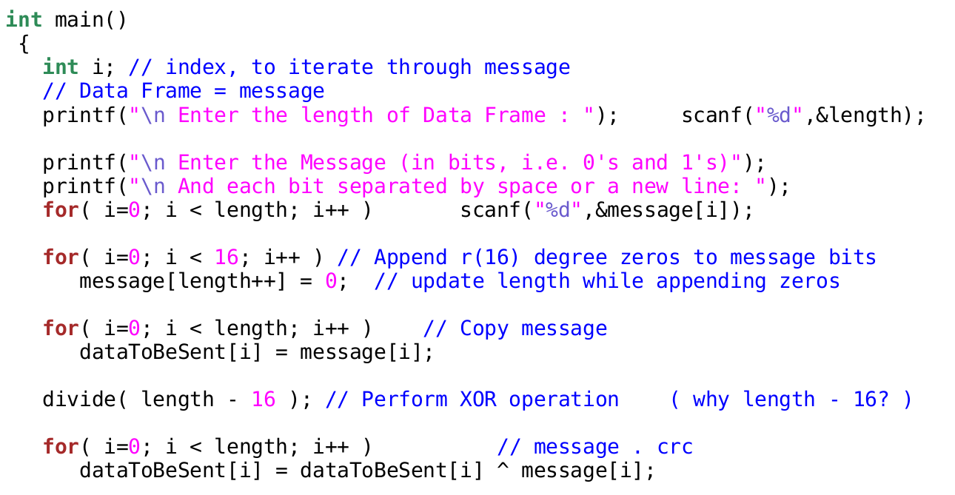

Slide 47
